Slide 1


Slide 2
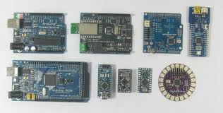
Many Faces of Arduino

Slide 3
Arduino is a standalone system?

Slide 4
Driver installation

Slide 5
Look for comport

Slide 6
Compile to check if code works

Slide 7

Hardware
Arduino Uno

Slide 8
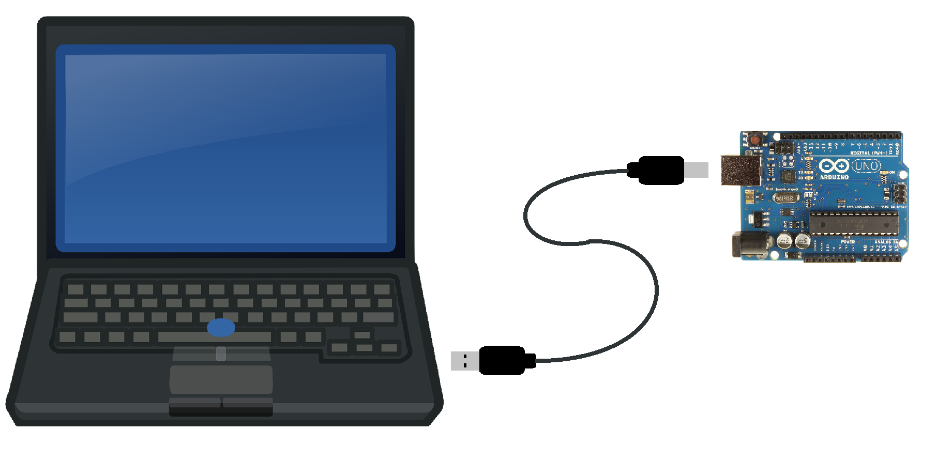
Powering & Programming the Arduino

Slide 9
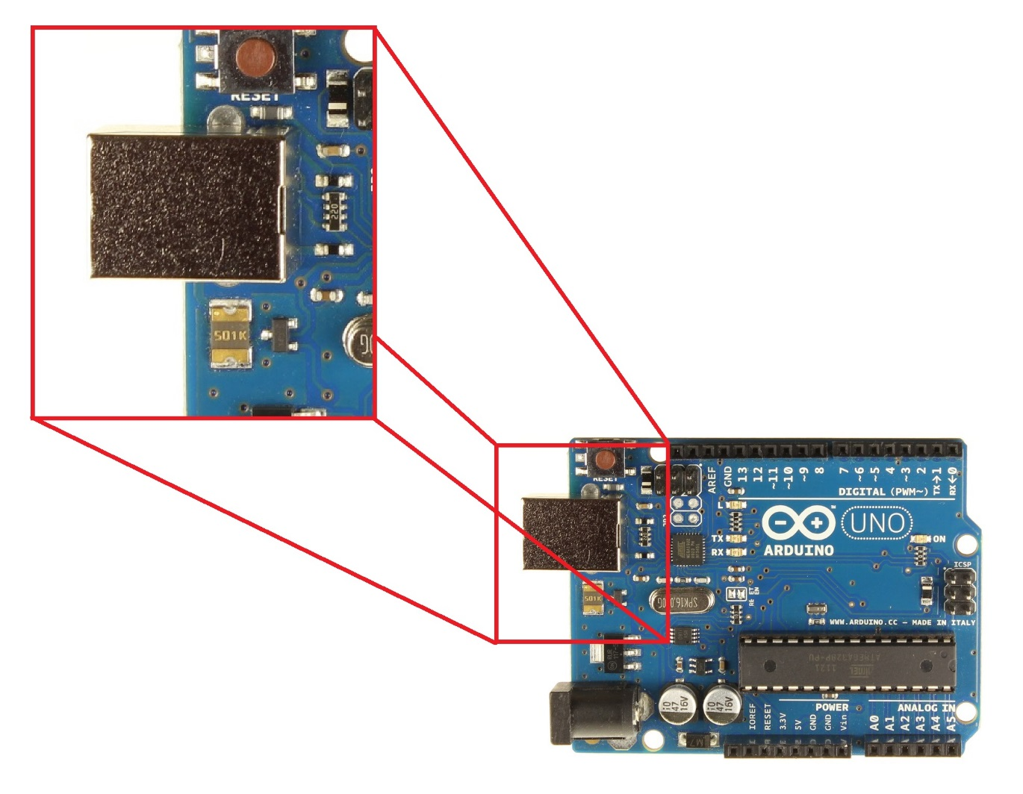
USB-Type B Port

Slide 10
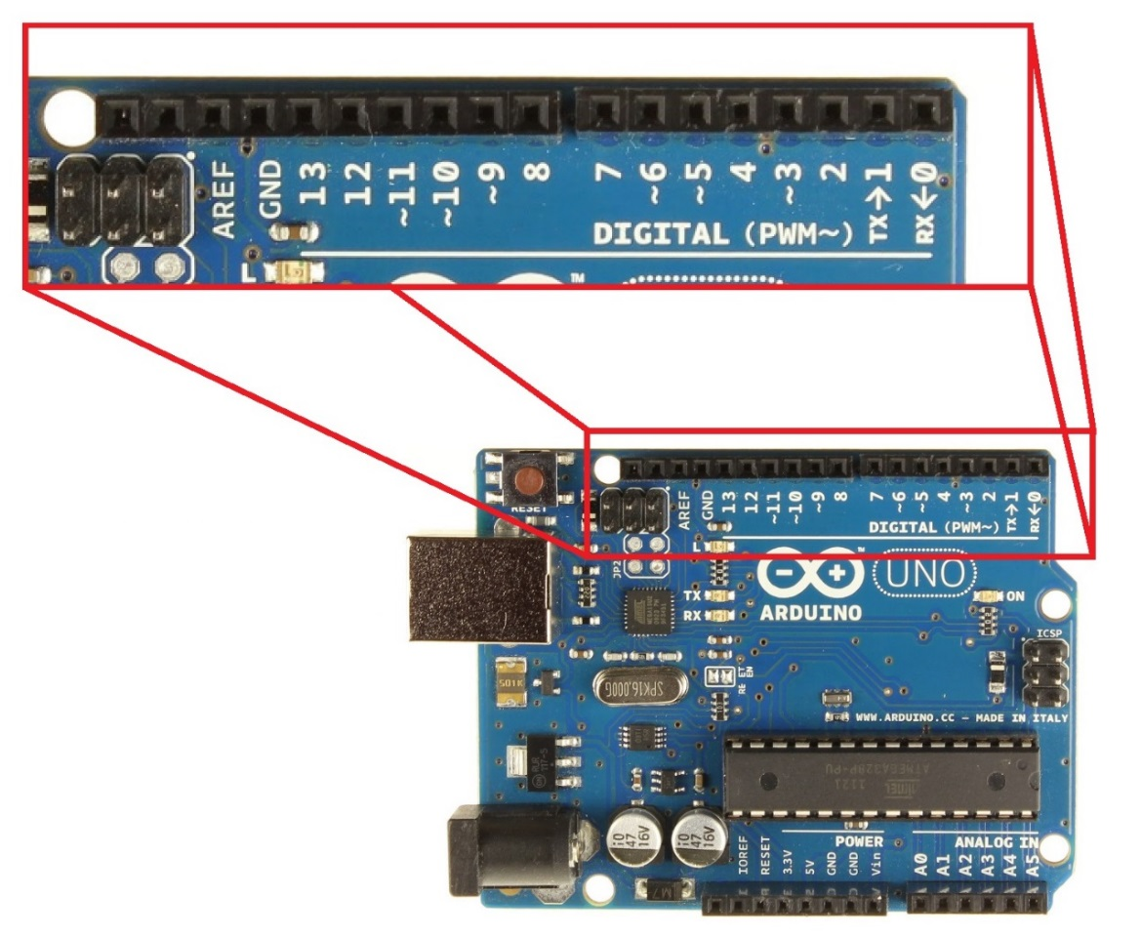

Digital Pins
Digital Signal
1 or 0
HIGH or LOW
5V or 0V
Example: A Light Switch

Slide 11
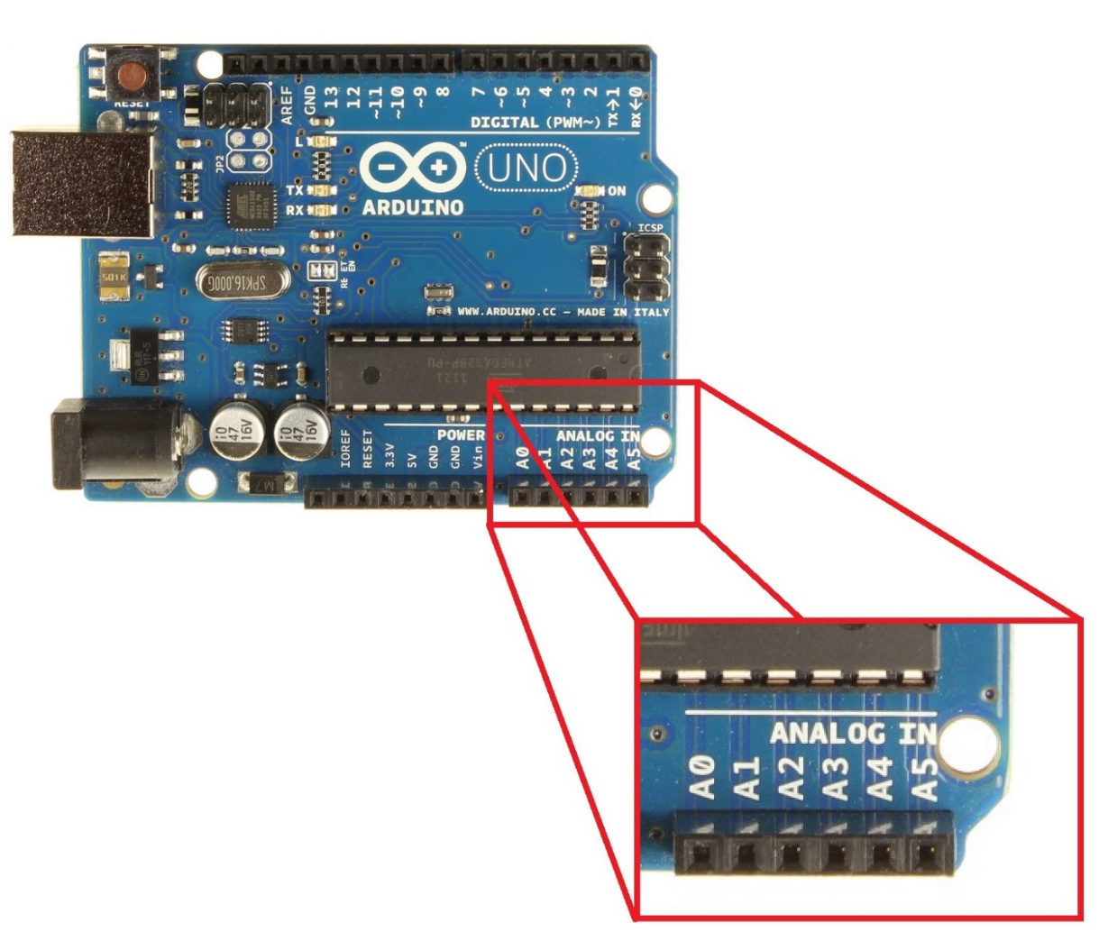

Analog Pins
Analog Signal
Varies
0V to 5V
Example: A Volume Knob

Slide 12
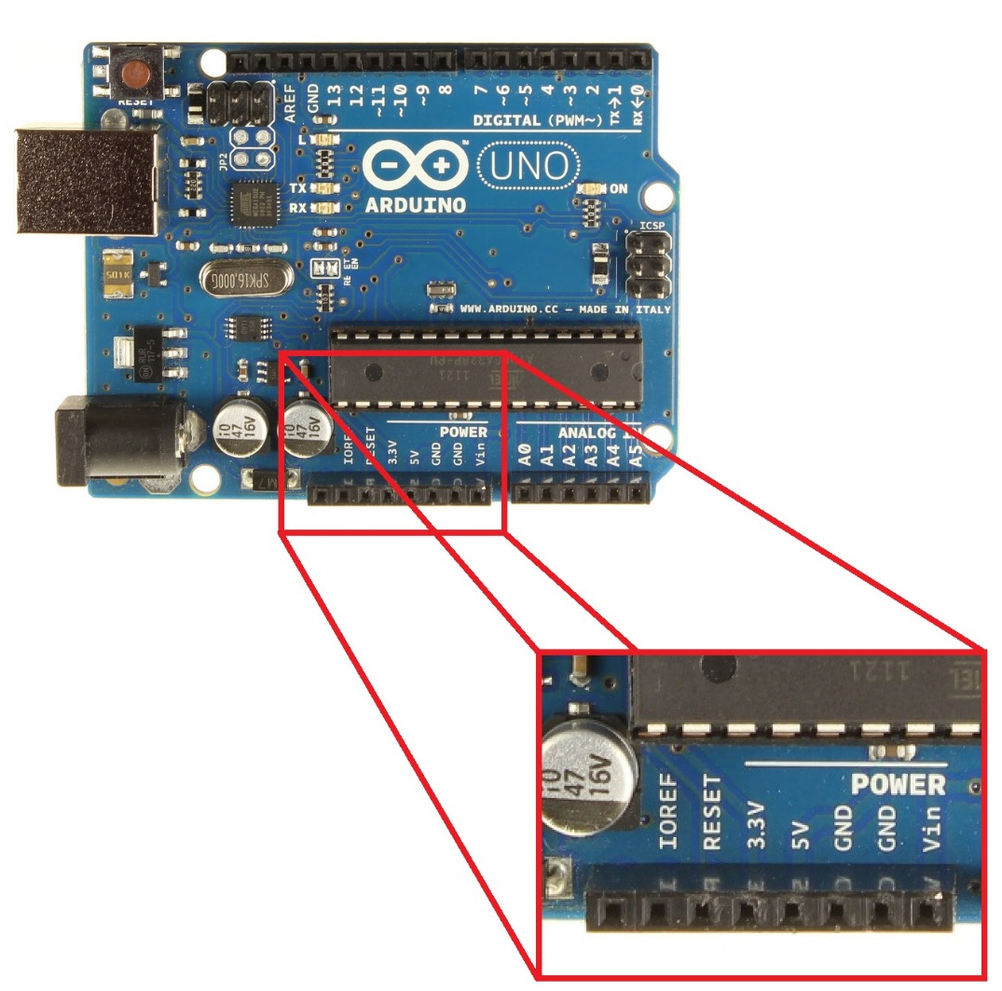
Power Pins
Provide and Receive
5V or 3.3V
Vin = Receive Power
GND = Ground
GND Rules!!
Arduino must always be grounded to any circuit that it is connected to

Slide 13
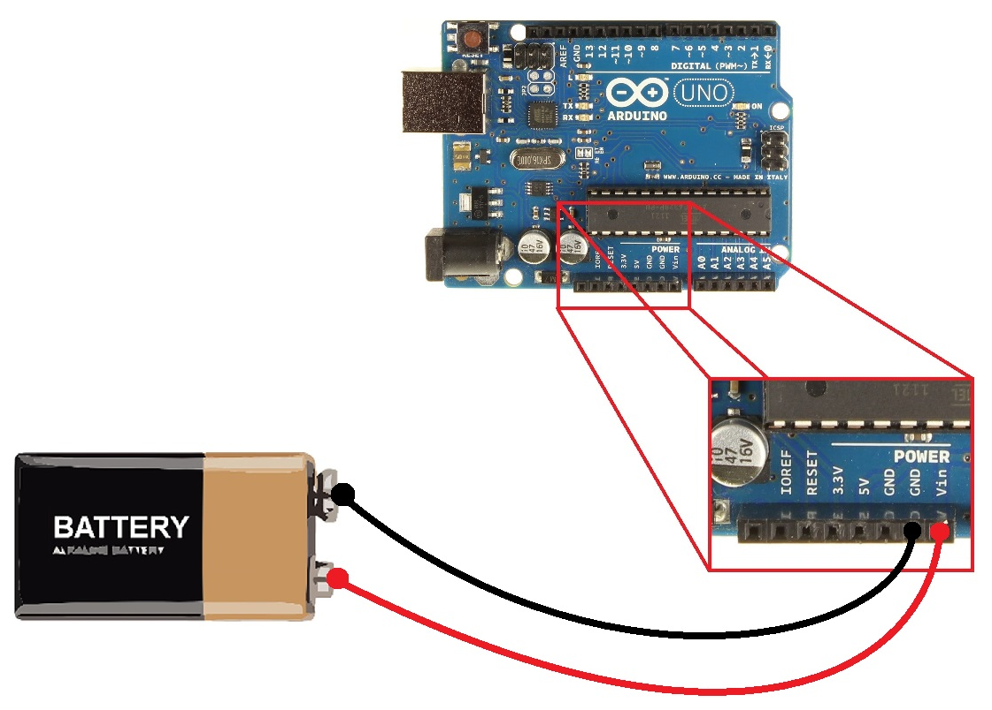
Powering the Arduino
Input Voltage
7-12 Volts Recommended
WARNING!!
Do not connect backwards

Slide 14
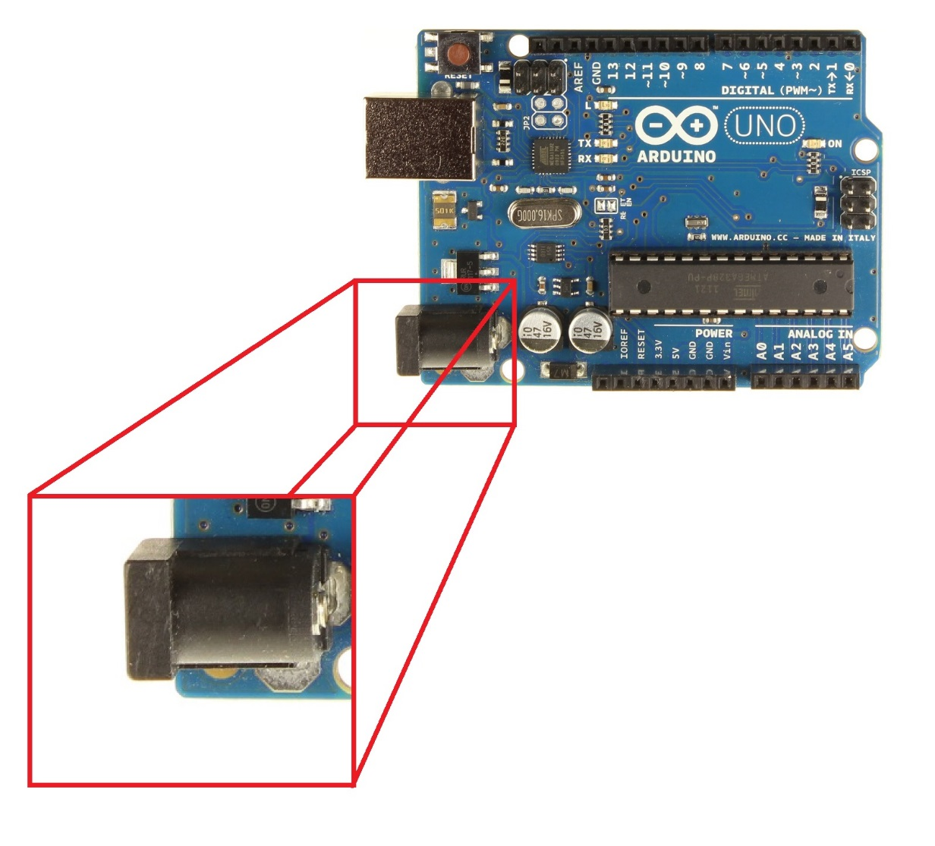
Powering the Arduino
Input Power
Barrel Jack

Slide 15
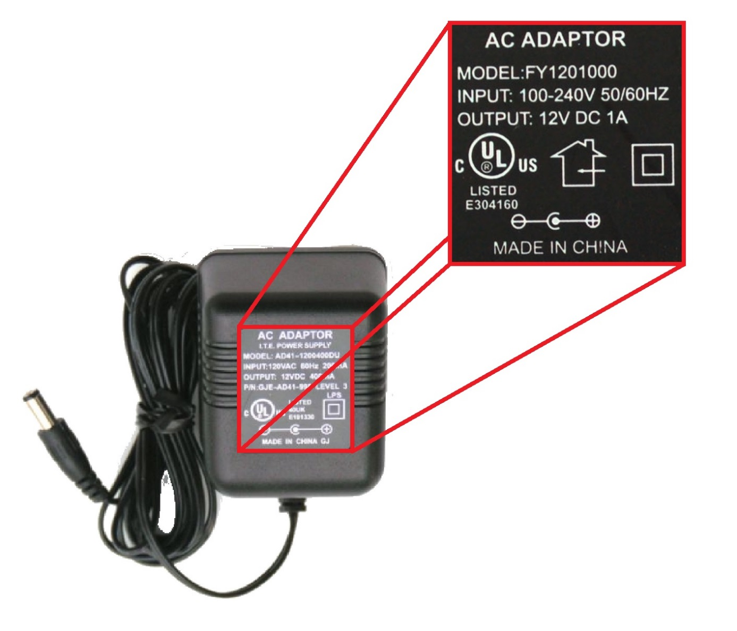
Power Supply
AC Adaptor
7-12 Volts Recommended
At least 250 milliAmps (mA)
WARNING!!
Plug must be center positive!!

Slide 16
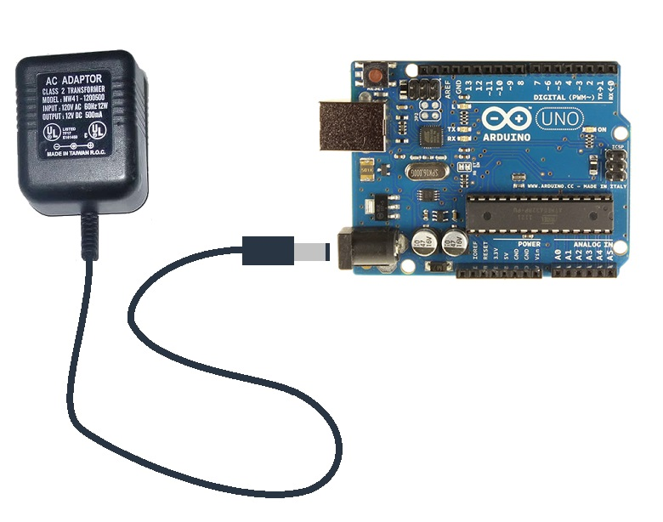
Powering the Arduino

Slide 17
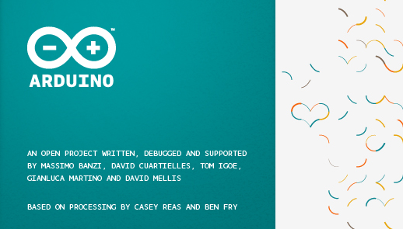
Software
Arduino IDE

Slide 18
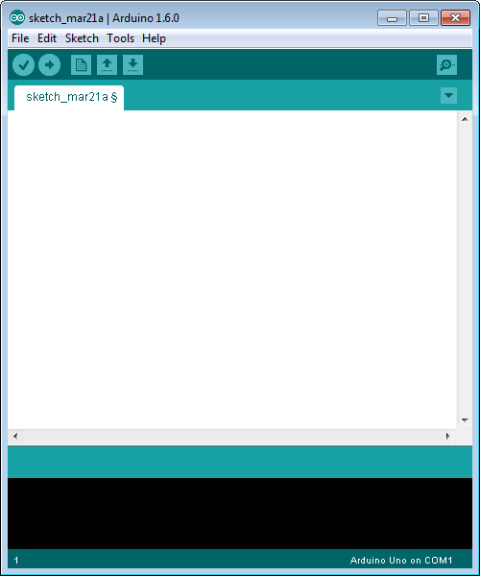
Blank Sketch

Slide 19
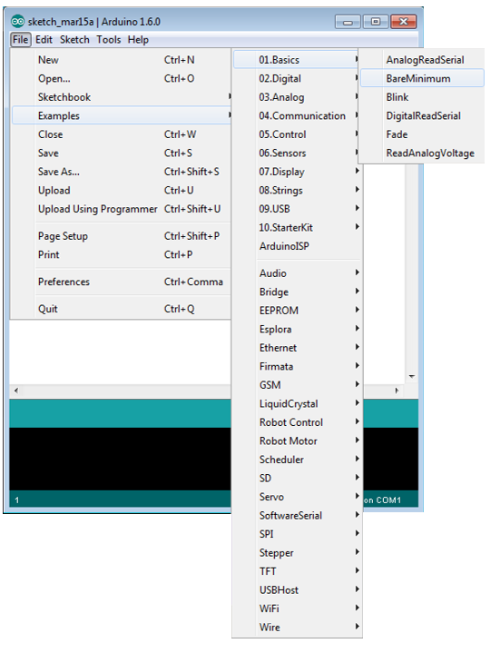
Find BareMinimum
File>Example>01.Basics>BareMinimum

Slide 20
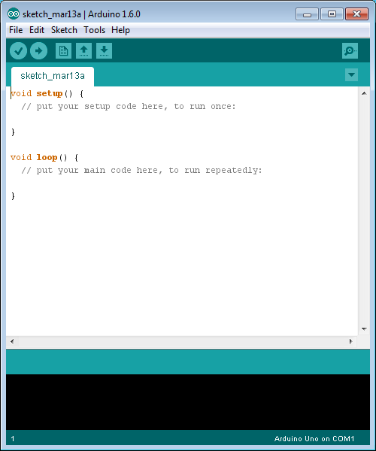
BareMinimum
void setup ()
Commands and variable declarations that need to be executed only once
Void loop ()
Commands and/or variable declarations that are constantly update

Slide 21
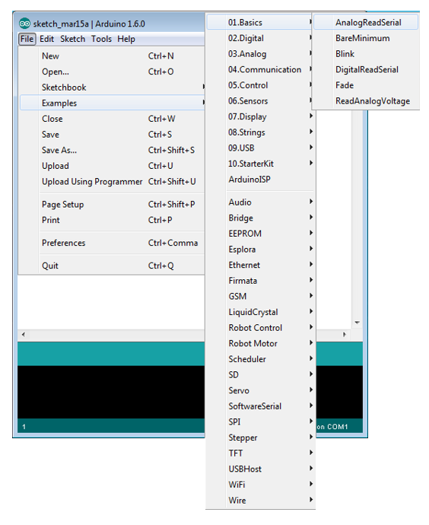
Find AnalogReadSerial
File>Examples>01.Basics>AnalogReadSerial

Slide 22
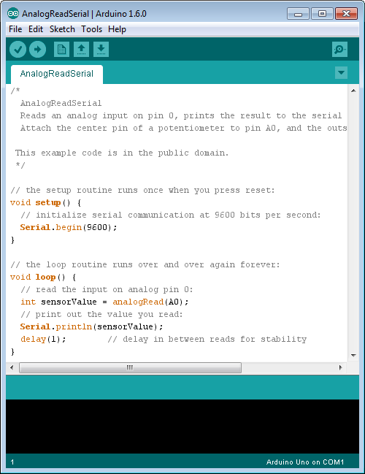
AnalogReadSerial
int x, y, josie
Serial.begin ()
analogRead ()
Serial.print ()
delay()

Slide 23

Resources

Slide 24
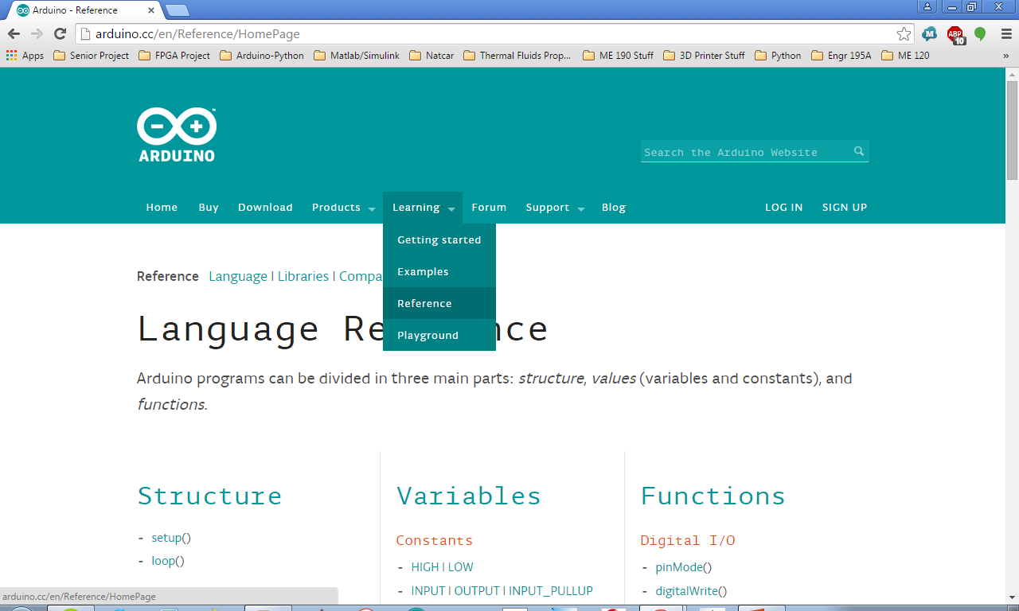
Learning>Reference

Slide 25
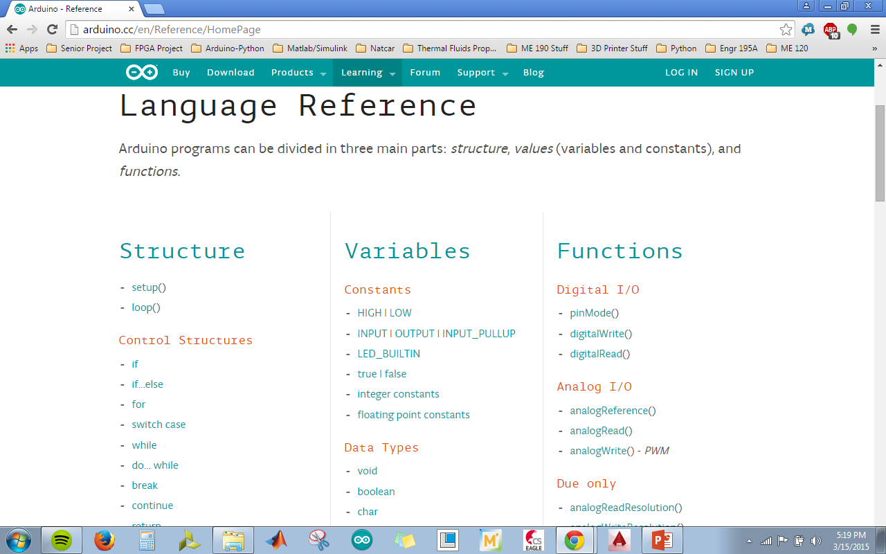
Commonly Used Commands

